Slide 1
Data Dictionary (for Process)

Slide 2
Data Dictionary - User Authentication Process
Process | User Authentication
Process Description | This process deals with User Authentication wherein the input parameters can be email id and password. If the input is authenticated, then the output will redirect the user to Home Page.
Inward Flow(s) | Login Credentials (Email ID, Password)
Outward Flow(s) | Authentication Approval, Response, Direct to Home Page
Process Specification | Attached in Next Slide

Slide 3
Structured English version of User Authentication (1.0)
IF LoginCredentials != Valid then
Ask user to enter valid Login Credentials
IF LoginCredentials == Valid then
IF LoginCredentials == True then
Direct to Home Page
IF LoginCredentials == False then
Direct to Login Page

Slide 4
Decision Table of User Authentication (1.0)
User Authentication Process
 | 1 | 2 | 3 | 4
Login Credential Validity | Y | Y | N | Y
Email ID registered | N | Y | N | Y
Password Matched | N | N | N | Y
Direct to Home Page (Authentication Approval, Response) | N | N | N | Y

Slide 5
Decision Tree of User Authentication (1.0)
Login Credential Valid
N
Prompt Validity Issue
N
Email ID registered
Send to Register Page
Password Matched
Y
Direct to Home Page
(Authentication Approval, Response)
Y

Slide 6
Data Dictionary (for Data flow)

Slide 7
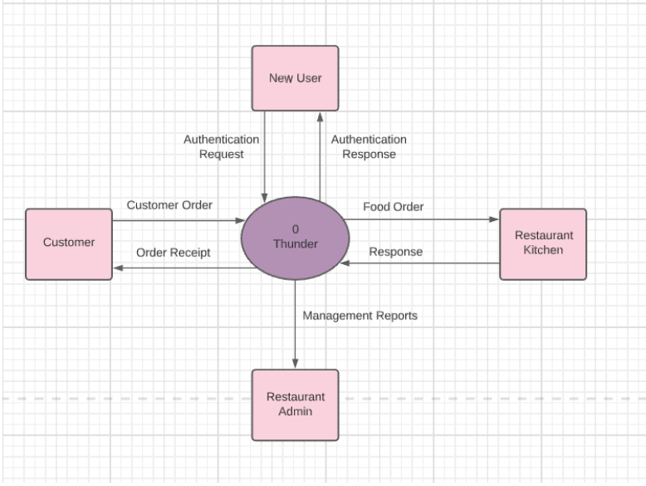
DFD Level 0

Slide 8
Data Flow of DFD Level 0
Sno. | Data | Description
1 | User Authentication (Email_id / Password) | This is the input entered by the user to login into the Thunder . The data is in the form of text
2 | Restaurant Profile List | It shows list of all the Restaurant available in the COS Market.
3 | Menu List | It shows the menu list of Restaurant selected by the customer.

Slide 9
Data Flow (User Info Input - Level 1)
Data Flow Name | User Info Input
Data Flow Description | This data flow contains the input entered during login and the response of system
Input Source | 1.0 User Register
Output Source | 3.0 Add Items to Cart

Slide 10
Data Dictionary (for Data Store)

Slide 11
Data Dictionary: Profile View
Field Name | Data Type | Data Format | Field Size | Description | Example
Name | Varchar2 | Text | 20 | Name of User | Harsh
Hostel Name | Varchar | Text |  | User’s Hostel | H
Email_ID | Varchar2 | --- | 30 | User’s Email Id | harshkashyap@gmail.com
Password | varchar | bcrypt | 10 | Password | *******
Phone no | Number | --- | 10 | User’s Phone no. | 8051789669
Room No. | Varchar2 | -- | 20 | User’s Room No. | E-205

